Slide 1
Link State
CCNA Exploration Semester 2
Chapter 10

Slide 2
Topics
Features and concepts of link state routing protocols
Benefits and requirements of link state routing protocols

Slide 3
Routing protocols
Interior
Exterior
Distance vector
Link state
RIP v1
RIP v2
IGRP
EIGRP
OSPF
IS-IS
EGP
BGP

Slide 4
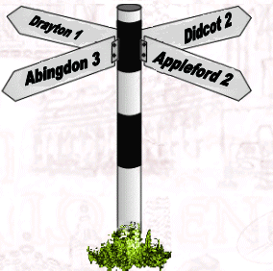
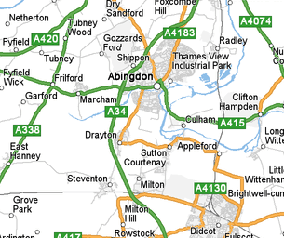
Distance vector and link state
Distance vector information is like having a signpost
Link state information is like having a map

Slide 5
Link state overview
Router sends information about its links – its directly connected networks – to all other routers
Every router builds up a picture of the topology of the routing domain
Every router works out its own best routes independently

Slide 6
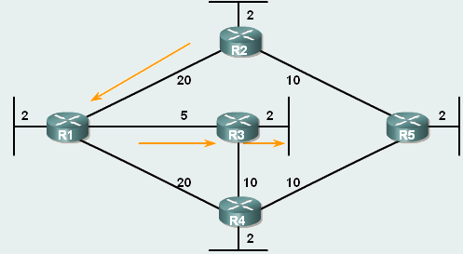
Dijkstra (shortest path first)
Router works out its own best path using a “cost” metric.

Slide 7
Link state – finding routes
Learn its own directly connected networks.
Exchange Hello packets to contact neighbours.
Build a Link-State Packet (LSP) including neighbor ID, link type, and bandwidth.
Flood the LSP to all neighbours. Neighbors then flood the LSPs to their neighbors until all routers in the area know all the links. Store a copy of each LSP in a database.
Use the database to make a map of the topology and find the best path to each network.

Slide 8
Link state information
Find out about own directly connected networks
Link 2:
Network 10.2.0.0/16
IP address 10.2.0.1
Type of network: Serial
Cost of link: 20
Neighbours: R2

Slide 9

Exchange of Hellos
Hello
Hello
Hello messages let neighbours discover each other and become adjacent.
Hellos continue to show that the neighbour is still there.

Slide 10
Make link state packet
Assemble all link state information on directly connected networks and make up packet.

Slide 11
Send and store link state packets
Flood packet to all adjacent neighbours.
Receive LSPs from neighbours and flood these out too.
All routers in the area receive information about all links in the area.
Each router stores the information in a database.
These databases should all be the same.

Slide 12
Link state packets
Routers do not send each other their results of their calculations (as EIGRP does)
They forward the LSPs as they receive them.
After this initial flooding they do not send LSPs again unless the topology changes.

Slide 13
Calculate routes
Each router takes the information from the topology database (same for all routers)
It works out a best route to each network, using the cost metric given for each link.
This gives a shortest path first tree which will be different for each router.
These paths go in the routing table.

Slide 14
Shortest path first tree
Tree has no loops
Least cost path to each network
RouterF
Via 172.16.11.0
cost 2
LAN
Via 172.16.9.0
cost 20
to RouterE
Via 172.16.5.0
cost 20
to RouterC
Via 172.16.10.0
cost 2
LAN
Via 172.16.8.0
cost 10
to RouterD
Via 172.16.4.0
cost 2
LAN
Via 172.16.2.0
cost 20
to RouterA
Via 172.16.0.0
cost 10
to RouterB
Via 172.16.7.0
cost 2
LAN
Via 172.16.3.0
cost 2
LAN
Via 172.16.1.0
cost 2
LAN

Slide 15
Link state advantages
Builds a Topological Map of the area as a shortest path first tree so loops are unlikely.
Fast Convergence because Link-state Packets are flooded at once and calculation is done afterwards.
Event-driven Updates rather than regular updates.
Hierarchical Design with multiple areas to allow route summarisation and isolation of problems.

Slide 16
Link state requirements
Requires RAM capacity to hold 3 databases.
Requires processor power for intensive calculations.
Bandwidth on initial flooding.
Use of areas can cut down the size of databases and the amount of processing on large networks, but this needs a skilled administrator.

Slide 17
OSPF and IS-IS
OSPF was designed by the IETF (Internet Engineering Task Force) so intended for use with IP
IS-IS was designed by ISO (International Organization for Standardization) for use with the OSI protocol stack. Support for IP was added. Used by ISPs and carriers.
OSPF is included in CCNA, IS-IS is not.

Slide 18
The End

